Slide 1


Here is Business Problem.

Slide 2
Business Problem “How can we optimize sales performance across products and regions by identifying key trends
and weaknesses from the Power BI dashboard?
Project Name
Sales Performance Analysis Report.
Name :Nourhan Abd Elgelil Zayed.

Slide 3
Agenda:
1- Executive Summary.
2- Key Insights & Performance Overview.
3- Recommendations for Decision Making.
4- Conclusion.

Slide 4
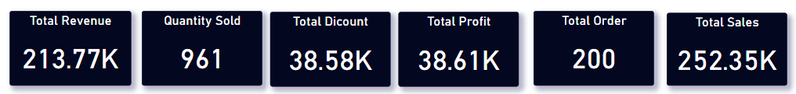
Executive Summary
This report provides an analysis of the sales performance based on key metrics displayed in the Power BI Sales Dashboard.
The goal is to identify trends, Insights, and actionable recommendations to enhance business decisions.
2. Key Insights & Performance Overview
Total Sales Performance
The total revenue generated during the analyzed period is $213.77K.
The revenue trend shows a decrease of 15.3% compared to the previous period, where the total sales before the discount were $252.35K.
1. Executive Summary
This report provides an analysis of the sales performance based on key metrics displayed in the Power BI Sales Dashboard. The goal is to identify trends, insights, and actionable recommendations to enhance business decisions.
1. Executive Summary
This report provides an analysis of the sales performance based on key metrics displayed in the Power BI Sales Dashboard. The goal is to identify trends, insights, and actionable recommendations to enhance business decisions.
1. Executive Summary
This report provides an analysis of the sales performance based on key metrics displayed in the Power BI Sales Dashboard. The goal is to identify trends, insights, and actionable recommendations to enhance business decisions.
1. Executive Summary
This report provides an analysis of the sales performance based on key metrics displayed in the Power BI Sales Dashboard. The goal is to identify trends, insights, and actionable recommendations to enhance business decisions.
1. Executive Summary
This report provides an analysis of the sales performance based on key metrics displayed in the Power BI Sales Dashboard. The goal is to identify trends, insights, and actionable recommendations to enhance business decisions.
1. Executive Summary
This report provides an analysis of the sales performance based on key metrics displayed in the Power BI Sales Dashboard. The goal is to identify trends, insights, and actionable recommendations to enhance business decisions.

Slide 5
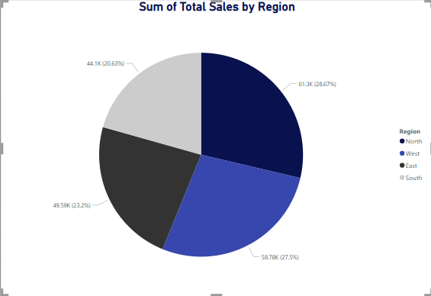
B. Sales by Region
The highest-performing region is North, contributing 28.67% to total sales. The lowest-performing region is South, indicating potential areas for improvement.

Slide 6
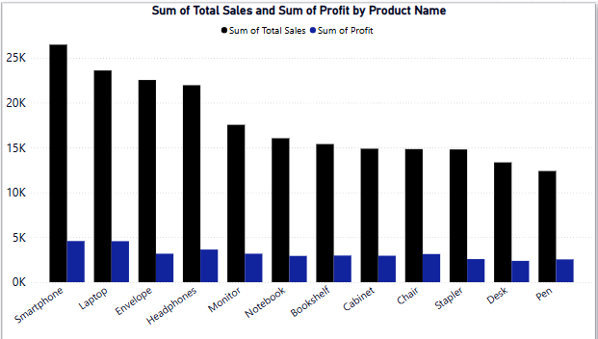
C. Product Performance
The best-selling product is Smartphone, accounting for 12.38% of total sales.
The least-performing product is Pen, with sales of 5.79%, requiring strategic intervention.

Slide 7
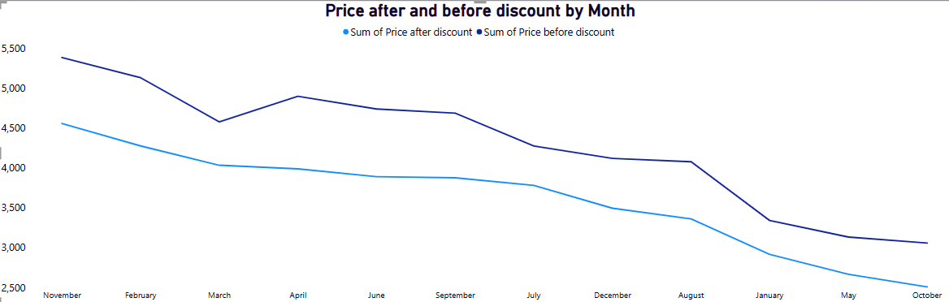
D. Sales Trends & Seasonality Analysis
The peak sales period was observed in November (11), with total sales of $27,205.39, indicating strong seasonal demand.
The lowest sales were recorded in January (1), with total sales of $11,334.76, requiring targeted marketing efforts to improve performance.

Slide 8
3. Recommendations for Decision Making
1- Boost sales in underperforming regions (e.g., South) by offering region-specific promotions, discounts, and personalized marketing campaigns. Consider partnerships with local distributors to increase reach.
2- Enhance product strategy by optimizing inventory management. Increase stock for high-demand products and reconsider pricing, bundling, or discontinuation strategies for low-performing.
3- Improve customer retention strategies by introducing loyalty programs, special discounts for repeat customers, and targeted email marketing campaigns to increase engagement.
4- Capitalize on seasonal trends by launching pre-season promotional campaigns. Since November showed peak sales, campaigns should start in October to maximize revenue. Offer limited-time bundles or holiday
discounts.

Slide 9
4. Conclusion
The Sales Dashboard highlights critical trends that can drive business growth. By acting on the recommendations provided, the company can optimize its sales strategy, enhance customer satisfaction, and maximize revenue generation.
This report has been generated based on the available data from the Sales Dashboard. Further analysis and deeper segmentation can be conducted for more granular insights.

